Slide 1
THESIS PROPOSAL ON Correlation-Adaptive Weather Graph Modeling for Precision Crop Recommendation in Complex Mountain Terrain
PRESENTED BY
YOUR Name Program Supervisor Date

Slide 2
Overview
Introduction
Problem Statement
Research Gap
Objectives
Methodology
Experimental Design
Evaluation Metrics
Expected Outcomes
Timeline

Slide 3
Introduction (Background)
Agriculture in Nepal is highly weather-dependent
Mountain terrain → complex microclimates
Existing CRS rely on accurate forecasting
STGCN enables spatio-temporal modeling
Problem: Geographic distance ≠ atmospheric similarity

Slide 4
Introduction (The Distance Trap in Mountain Terrain)
Nearby stations can have very different weather
Valley station (5 km): 20°C
Ridge station (5 km): 5°C
Distant valleys may show similar atmospheric behavior
Geographic proximity ≠ atmospheric similarity

Slide 5
PROBLEM STATEMENT
Distance-based adjacency:
Aᵢⱼ = exp(− dᵢⱼ² / σ²)
Where dᵢⱼ is the geodesic distance between stations i and j
Assumes spatial smoothness.
Fails in mountains due to:
Elevation differences
Terrain barriers
Microclimate variation
Result:
“Distance Trap”
Poor forecasts → unreliable crop recommendations

Slide 6
Research Gap
Distance-based graphs dominate forecasting
Climate studies show teleconnections exist
Missing:
Functional (correlation-based) topology
Terrain-aware evaluation
Integration into crop recommendation systems

Slide 7
Objectives
Primary Objective
Improve forecasting + crop recommendation in mountainous terrain
Specific Objectives
Build correlation-based graph (320 stations)
Implement STGCN
Compare vs distance-based graph
Evaluate crop prediction accuracy
Perform terrain-based analysis

Slide 8
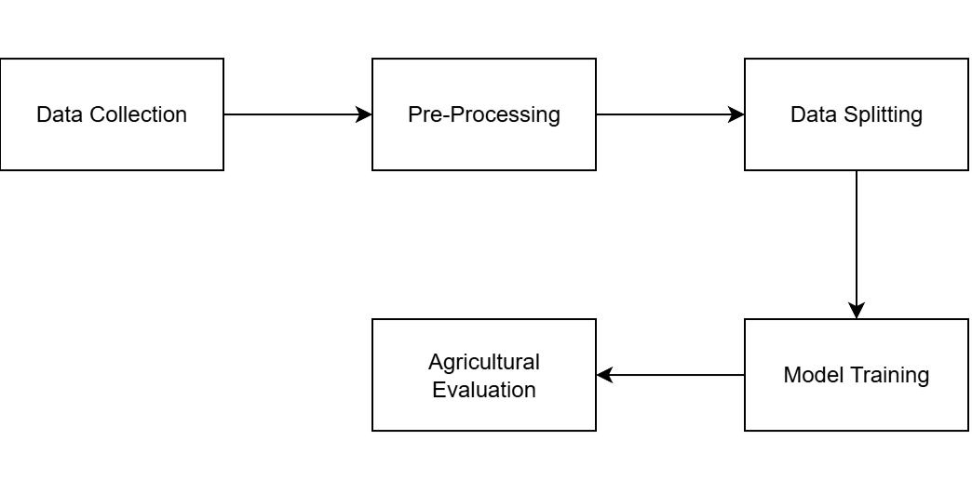
Methodology (Overall Methodology Framework)

Slide 9
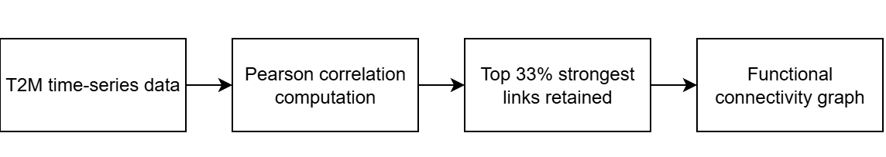
Methodology (Correlation-Adaptive Graph Construction)

Slide 10
Methodology (STGCN Model)
Model
Temporal Convolution
Graph Convolution (K = 3)
Multi-layer architecture
Output
7-day forecast
Temperature, Humidity, Rainfall
Key Idea
Uses correlated neighbors
Forms a virtual sensor network

Slide 11
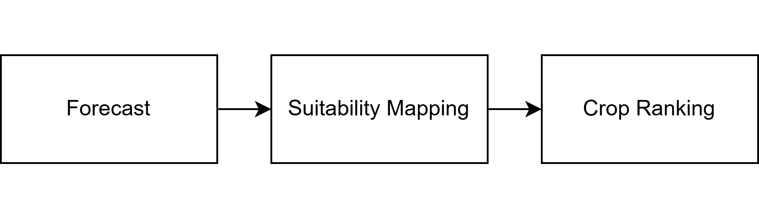
Methodology (Crop Recommendation Integration)
Input
Forecasted weather (Temp, Humidity, Rainfall)
Method
Biometric threshold mapping
Example: Rice → Temp > 20°C, RH > 80%
Optional: Random Forest classifier
Output
Ranked crop recommendations

Slide 12
Experimental Design
Compare
Distance-based STGCN
Correlation-based STGCN
Baselines
LSTM (no graph structure)
IDW interpolation
Controlled Factors
Same dataset
Same architecture
Same hyperparameters
Same forecasting horizon

Slide 13

Evaluation Metrics
 | Actual Positive | Actual Negative
Predicted Positive | TP | FP
Predicted Negative | FN | TN
Accuracy : Indicates overall classification correctness.
Accuracy = $\frac{TP + TN}{TP+TN+FP+FN}$
Precision : Measures reliability of positive crop recommendations.
Precision = $\frac{TP}{TP+FP}$

Slide 14
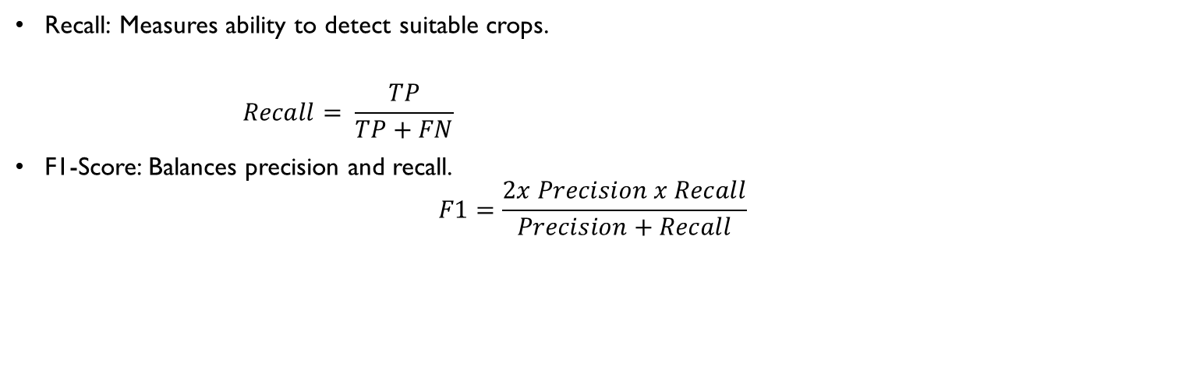
Evaluation Metrics Cont.'s
 | Actual Positive | Actual Negative
Predicted Positive | TP | FP
Predicted Negative | FN | TN
Recall: Measures ability to detect suitable crops.
$$Recall= \frac{TP}{TP+FN}$$
F1-Score: Balances precision and recall.
$$F1=\frac{2x Precision x Recall}{Precision+Recall}$$

Slide 15
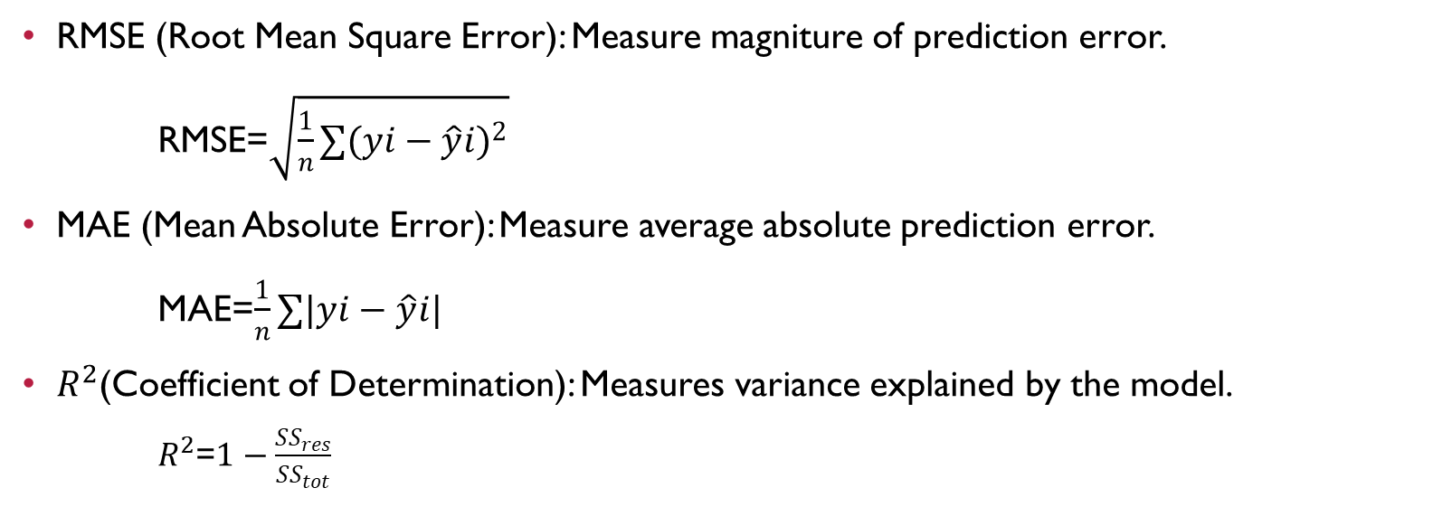
Evaluation Metrics (Forecasting Metrics)
RMSE (Root Mean Square Error): Measure magniture of prediction error.
RMSE=$\sqrt{\frac{1}{n}∑{(yi−\hat{y}i)}^{2}}$
MAE (Mean Absolute Error): Measure average absolute prediction error.
MAE=$\frac{1}{n}∑|yi−\hat{y}i|$
$R^{2}$(Coefficient of Determination): Measures variance explained by the model.
$R^{2}$=$1−\frac{{SS}_{res}}{{SS}_{tot}}$

Slide 16
Expected outcomes
Methodological: Correlation-adaptive graph topology for mountainous terrain
Technical: Improved forecasting accuracy in high-relief zones
Practical: More reliable crop recommendation in complex terrain
Hypothesis: Correlation-based adjacency reduces forecast error and improves crop recommendation reliability

Slide 17
TImeline
Month 1–2: Data preprocessing & graph construction
Month 3: Baseline implementation
Month 4–5: Model training & tuning
Month 6: Comparative evaluation
Month 7: Agricultural validation
Month 8: Thesis writing & revision

Slide 18
THANK YOU !! Questions?

